Slide 1
Gen AI Test-hub
Test scenarios generator powered by gen-ai

Slide 2
Gen ai test-hub
About the App
Architecture
Tech Stack
Key Features
Workflows
Future Enhancements

Slide 3
About the app
The Gen AI Test-Hub web application serves as a powerful solution for generating test scenarios with the aid of Generative AI technology.
Its primary purpose is to streamline and enhance the test case creation process, making it accessible and efficient for software developers and testers.

Slide 4
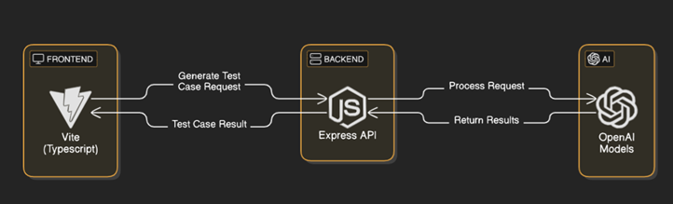
architecture

Slide 5
Tech stack
Frontend Technologies
React
Vite frontend
Tailwind CSS
TypeScript
Backend Technologies
Node.js
Express API
Gen AI Interaction
OpenAI

Slide 6
Key features
Multiple domain support
Financial Domains
UI testing
Gen-AI based
- OpenAI model
User Interactive
Custom Requirements
Feedbacks
Reporting

Slide 7
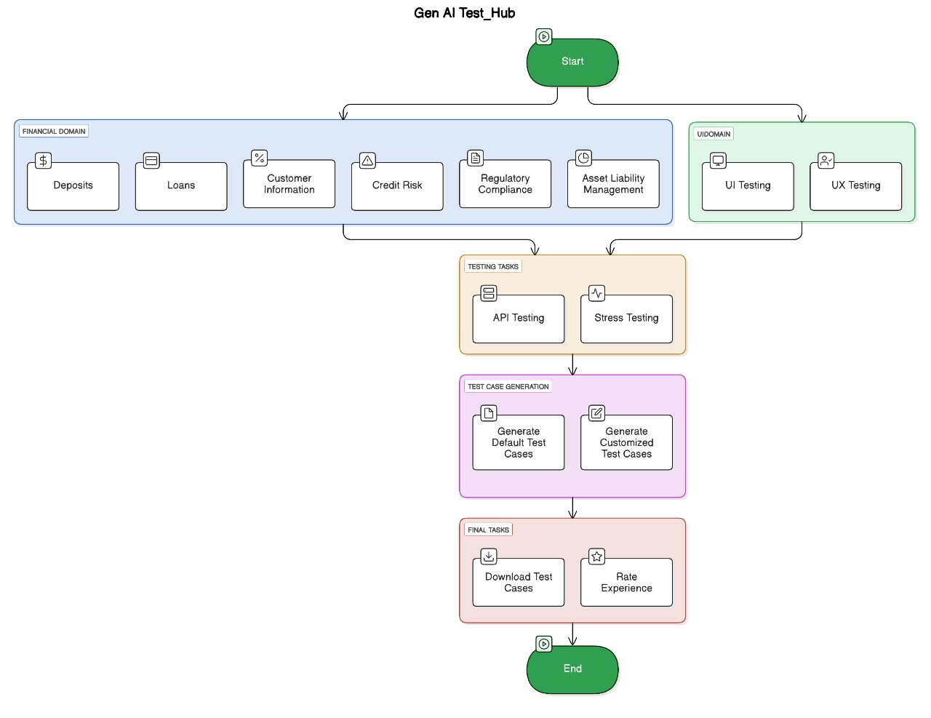
Workflow

Slide 8
workflows
User Interaction with the Domain Selection
Category Selection
Testing Requirement
Feedback and Reporting Functions
- Rating the responses
- Downloading reports
Test Scenario Generation Process
- OpenAI facilitated test scenarios generation
- Custom Scenarios Prompting
- Processing custom prompts

Slide 9
Future enhancements
Support additional testing categories
Enhanced user interface testing
Integration with external test management tools
Test Categories
Performance, Security, Usability
UI Testing
Accessibility, Layout, Dead links
Testing Tools
JIRA, TestRail, JMeter, Selenium

Slide 10
THANK YOU
Gen ai gladiators
team

